Slide 1
Hand Gesture Recognition
Daksh Gupta
Saurabh Jadhav

Slide 2
Steps of Algorithm
Convert RGB Image to HSV Color Space
Extract saturation component
Apply smoothing
Apply threshold to the image
Find the largest BLOB
Detect the edges
Classify the gestures

Slide 3
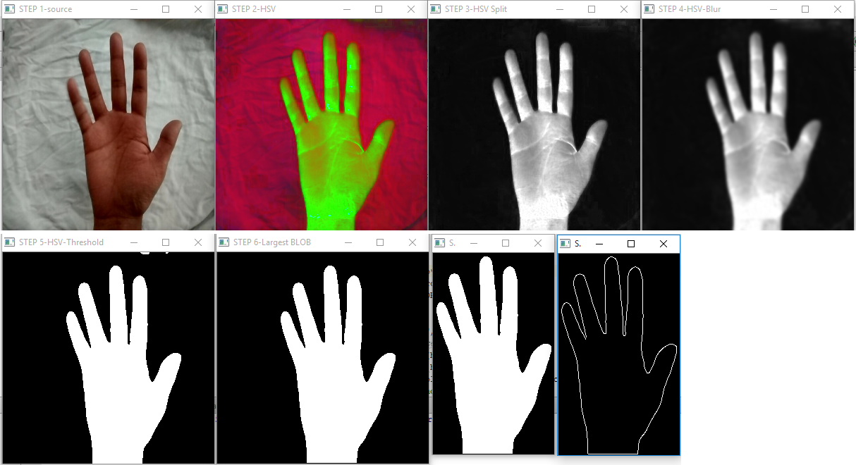
Steps of Algorithm

Slide 4
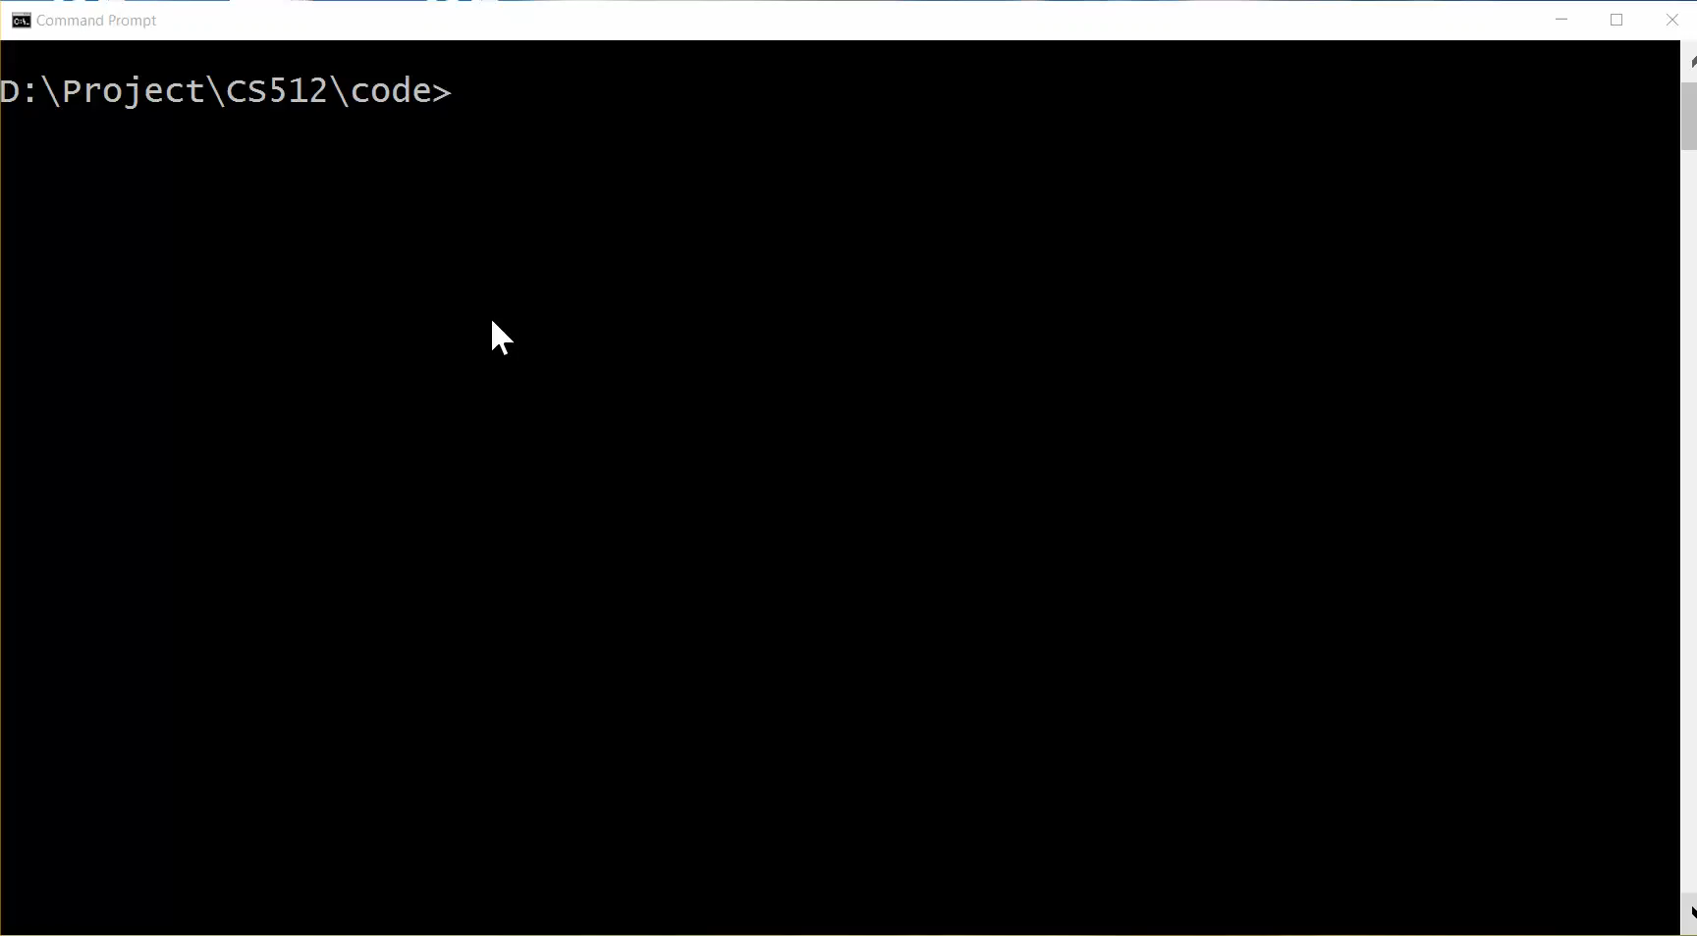
Demo

Slide 5
Results and Conclusion
Gestures | Success Ratio (%)
Open Palm | 37.5
Closed Palm | 100
one | 100
two | 100
three | 100
four | 100
up | 100
down | 100
Most of the gestures were recognized without any error.

Slide 6
References
Singha, J., Das, K.: Hand Gesture Recognition Based on Karhunen-Loeve Transform. Mobile & Embedded Technology International Conference 2013

